Slide 1
Basic Rules:
Continue the remove process when there are more than 2 substrates(except for inorganic compounds).

Slide 2
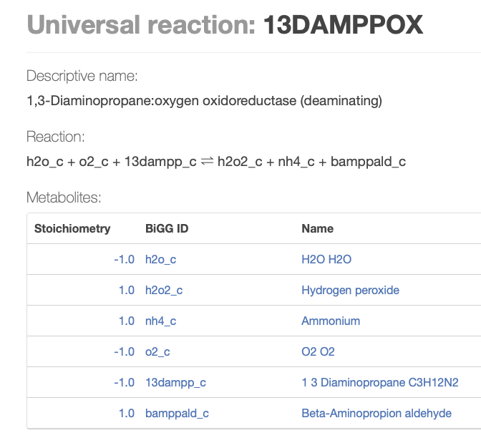
Step1
Remove inorganic compounds.

Slide 3
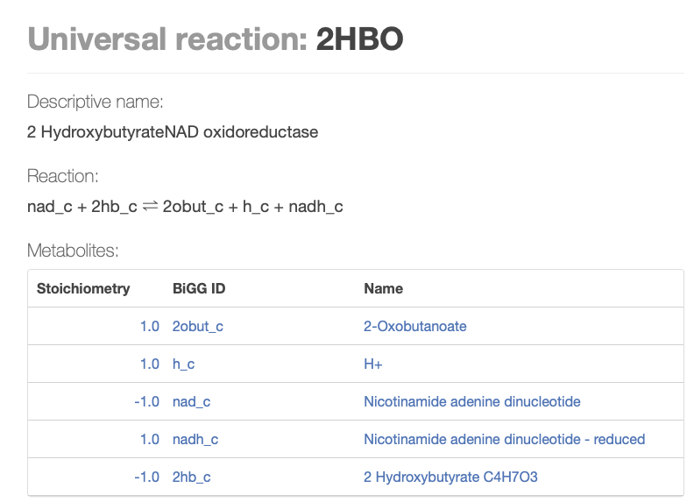
Step2
Remove cofactor pairs

Slide 4
Step3
Remove CoAs
Rule 1: If A->B+CoA or CoA+A->B,remove CoA.
Rule 2: If A+R1-CoA-> B+R2-CoA,remove R1-CoA, R2-CoA(may cause problem, need to adjust with carbon number)
Rule 3: remove CoA, acCoA pair
Rule 4: remove CoA, malCoA pair

